Slide 1
Face Recognition and tracking Attendance
- Prabhakar Jha

Slide 2
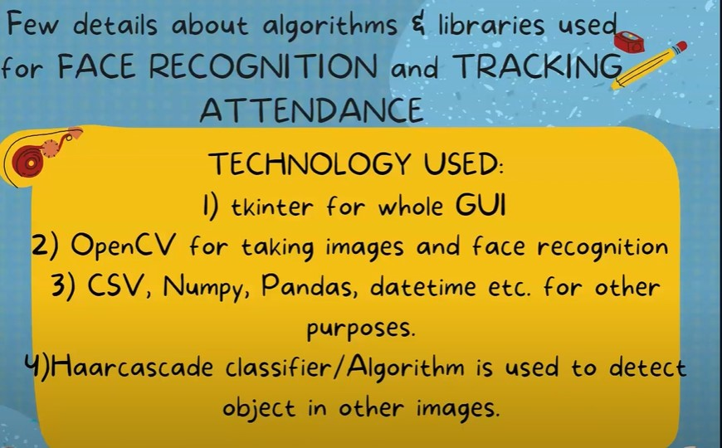

Slide 3
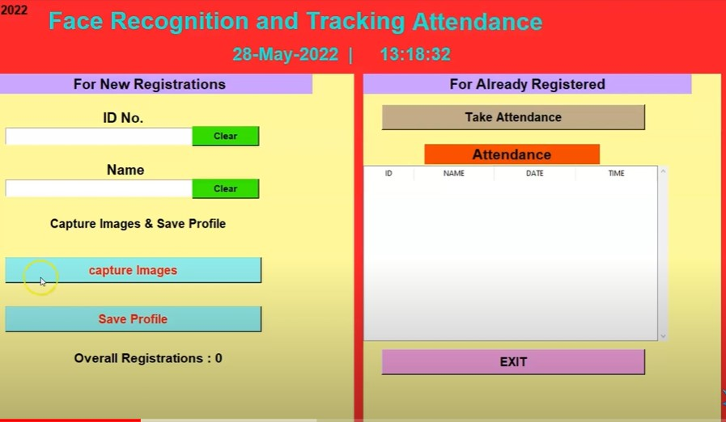
GUI

Slide 4
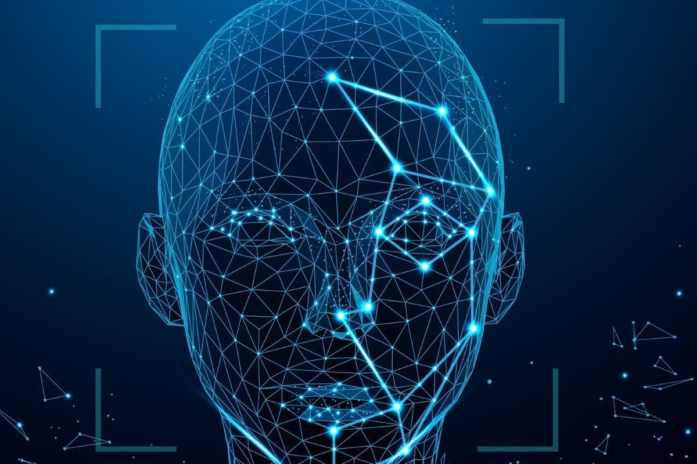
Demo
Registration
Register yourself using Id and Name.
Face Detection
Capture Image.
Save
Save profile using Password.

Slide 5
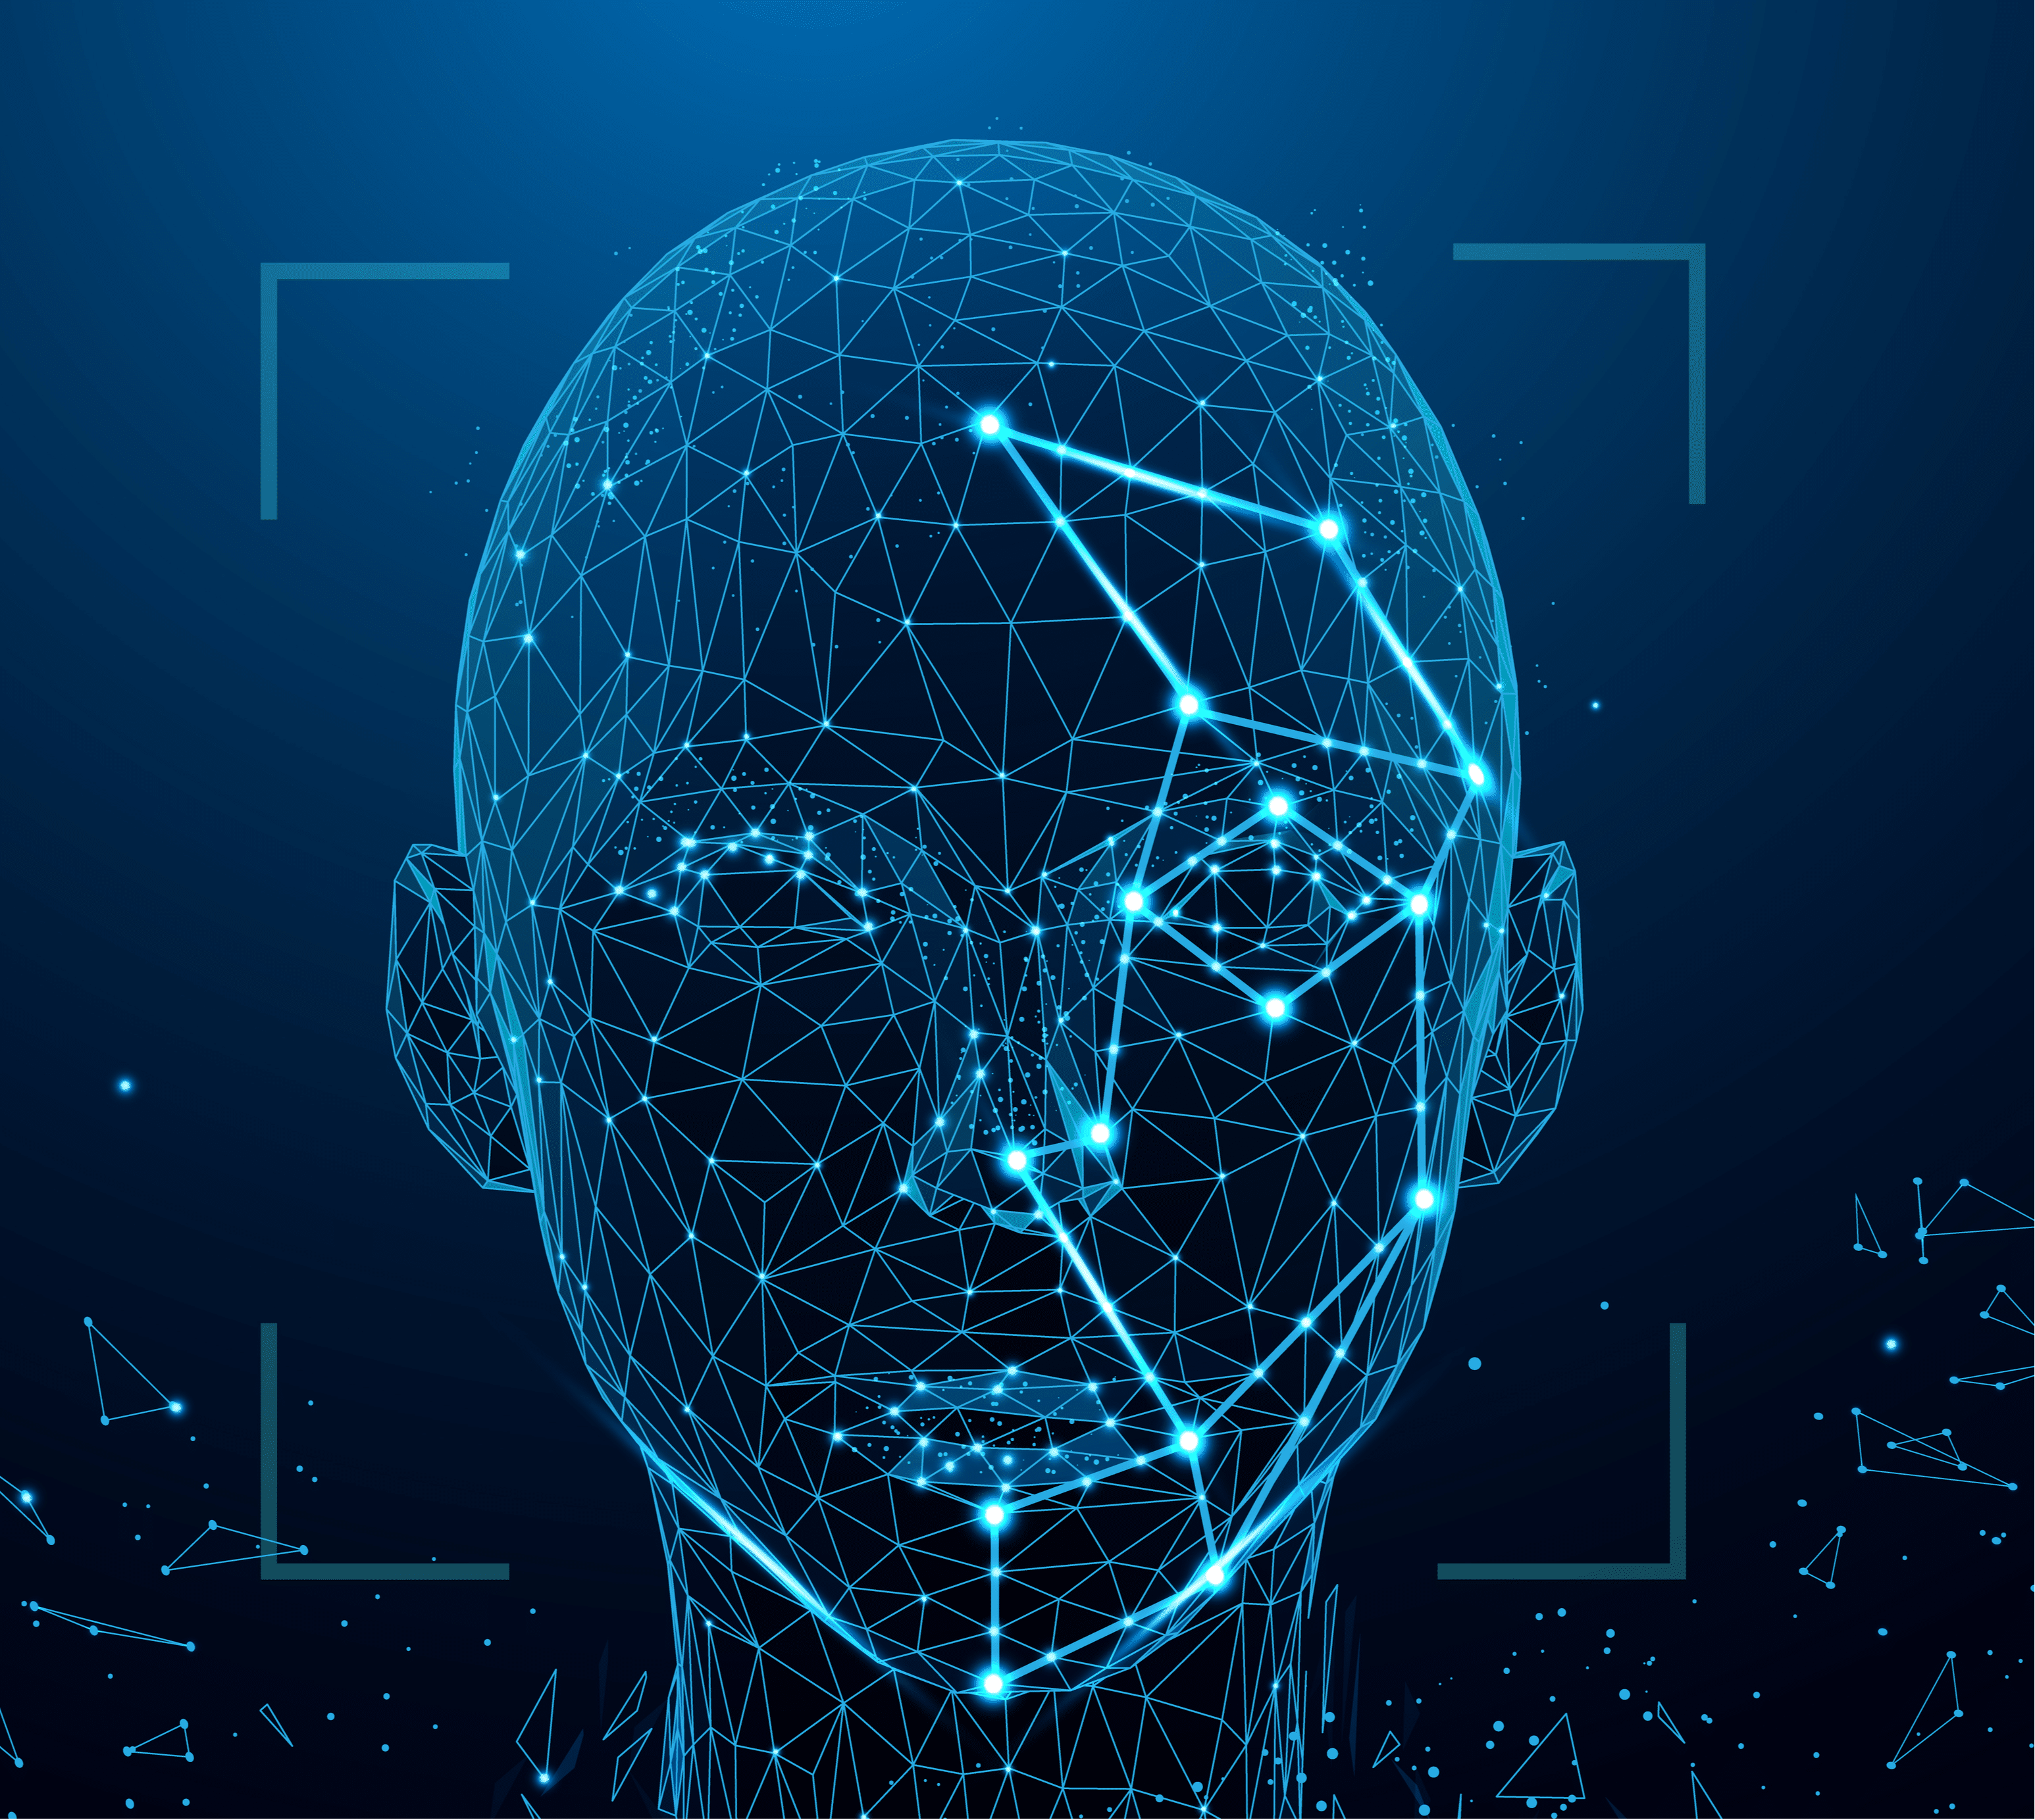
Attendance
Take Attendance via Recognizing the Face.
Save
Save Attendance.

Slide 6
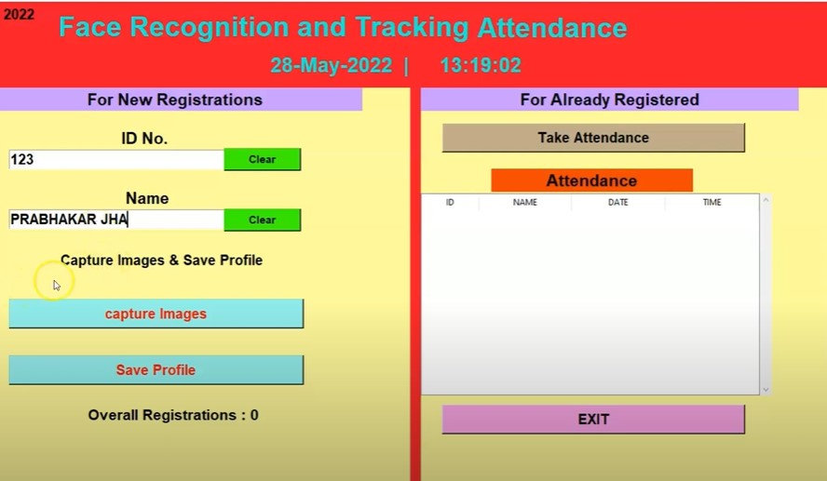
Registration

Slide 7
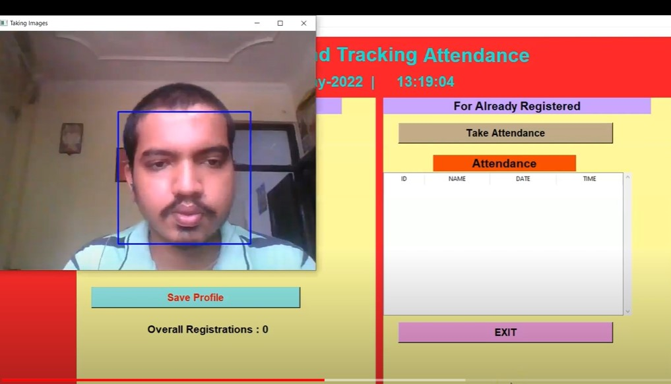
Face Detection

Slide 8
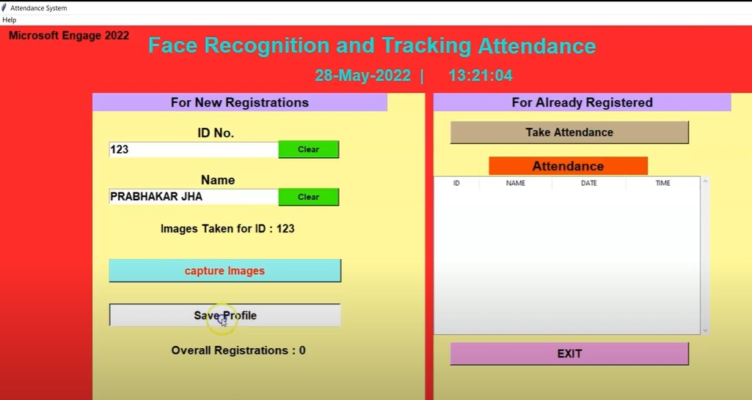
Save Profile

Slide 9
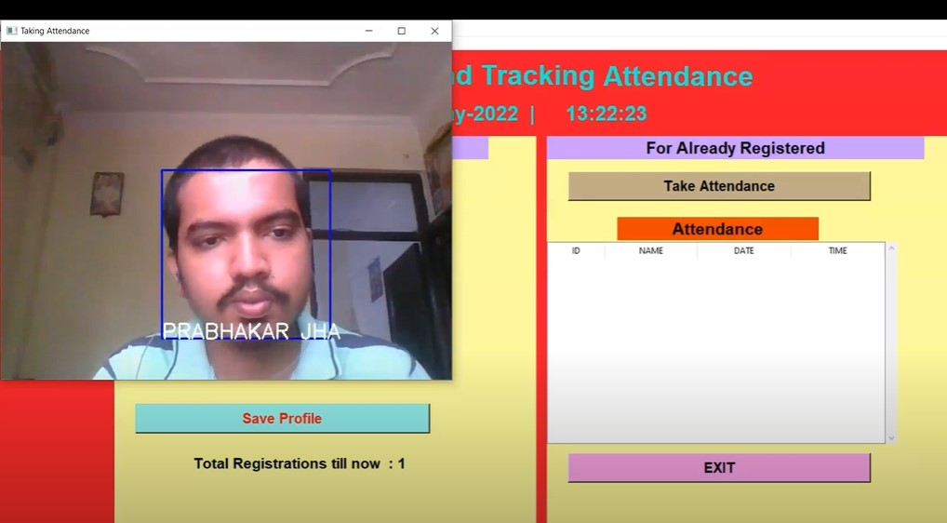
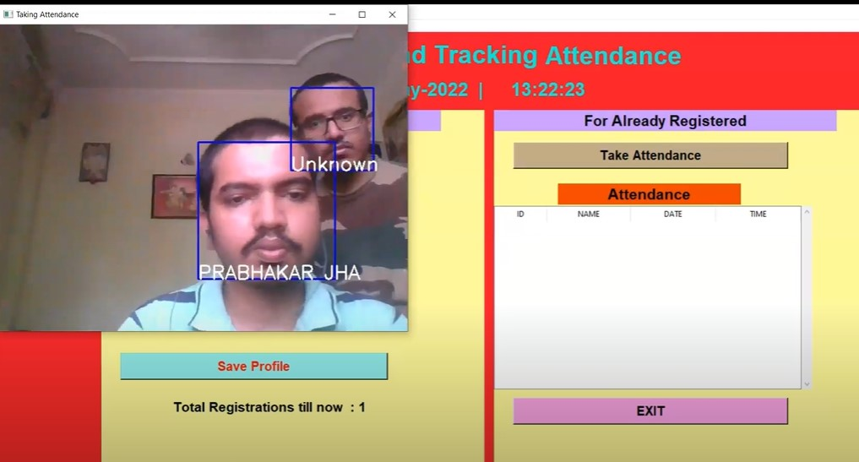
Face Recognition

Slide 10
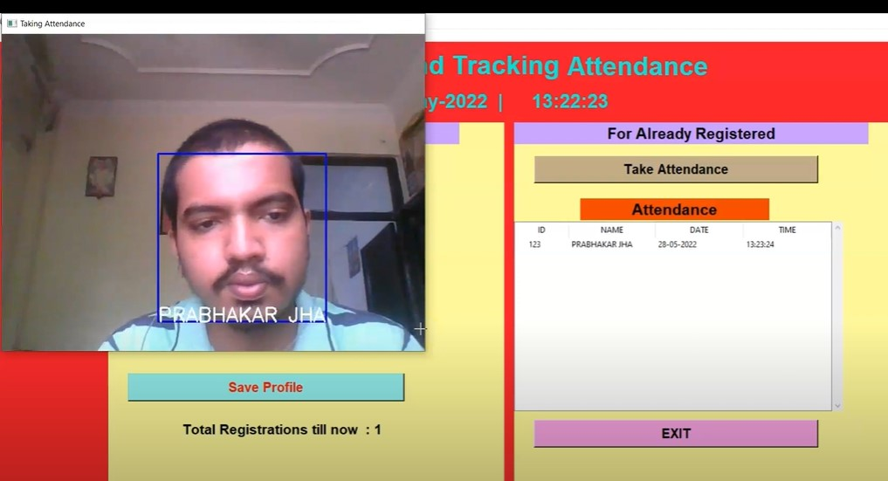
Save Attendance

Slide 11
Thank you

